Slide 1
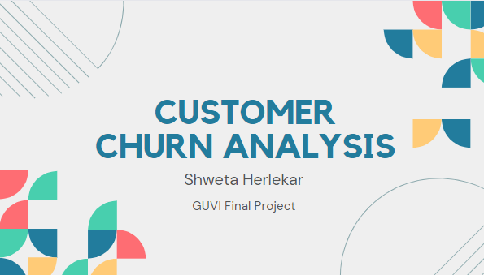

Slide 2
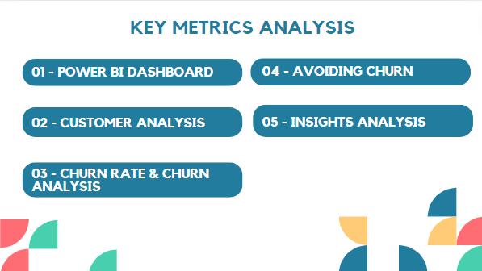

Slide 3
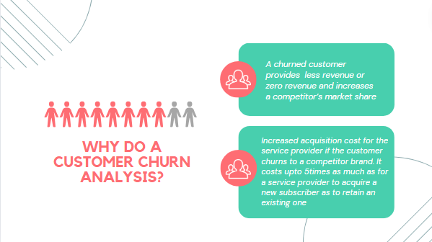

Slide 4
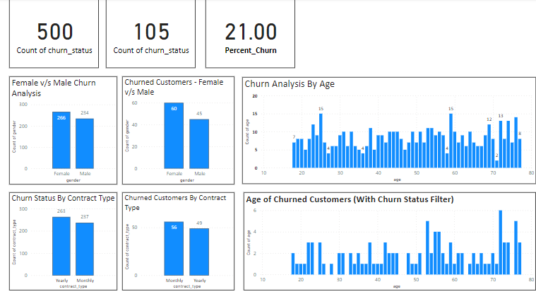

Slide 5
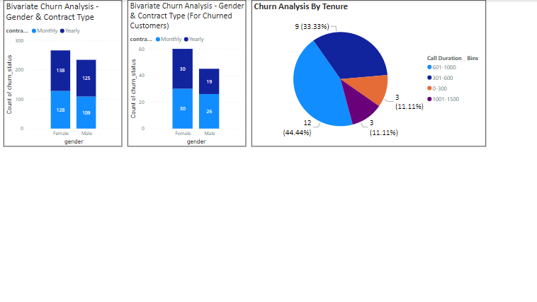

Slide 6
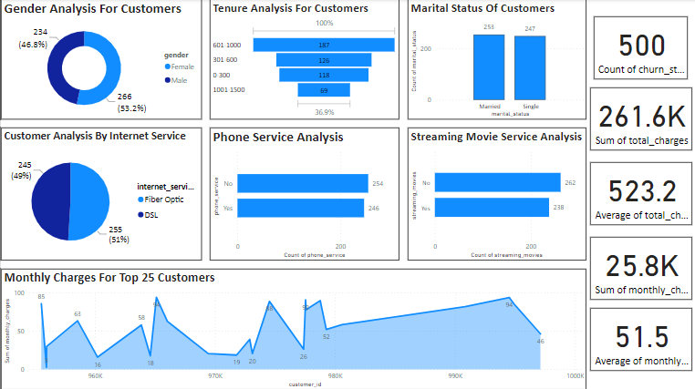

Slide 7
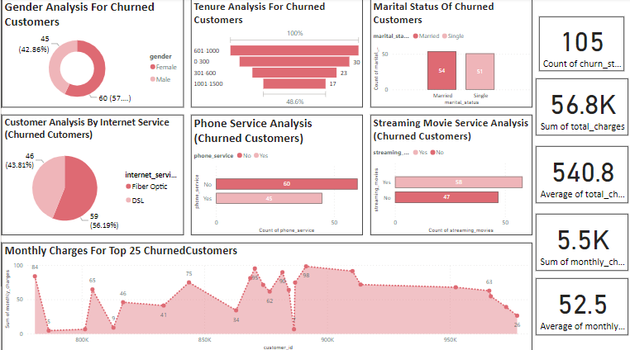

Slide 8
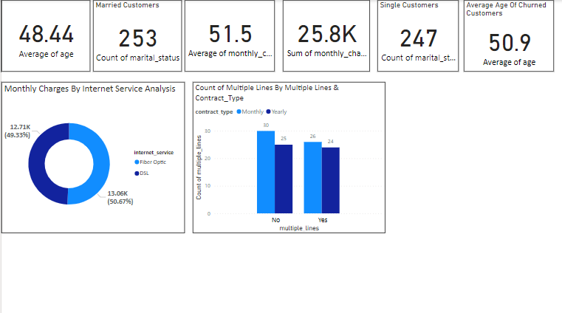

Slide 9
Insights Analysis
General Customer Analysis:
Gender Distribution:
Female: 47%
Male: 53%
The distribution of male and female customers is almost even, with a slight majority of male customers.
Tenure Analysis:
Most customers have a tenure between 0-100 months, with 36.9% in this category.
There is a significant drop-off in the number of customers as tenure increases, suggesting that customer retention decreases over time

Slide 10
Insights Analysis
Marital Status:
Married: 253
Single: 247
There is an almost even split between married and single customers.
Internet Service:
Fiber Optic: 51%
DSL: 49%
Fiber optic is slightly more popular than DSL among customers.

Slide 11
Insights Analysis
Phone Service:
Yes: 246
No: 254
Slightly more customers do not have phone service compared to those who do.
Streaming Movie Service:
No: 262
Yes: 238
More customers do not subscribe to streaming movie services.

Slide 12
Churned Customer Analysis
Gender Distribution:
Female: 42.86%
Male: 57.14%
A higher proportion of churned customers are male.
Tenure Analysis:
The majority of churned customers have a tenure between 0-100 months.
A noticeable decrease in churn as tenure increases beyond 300 months.

Slide 13
Churned Customer Analysis
Marital Status:
Married: 54
Single: 51
A slight majority of churned customers are married.
Internet Service:
Fiber Optic: 56.19%
DSL: 43.81%
More churned customers had fiber optic internet service.

Slide 14
Churned Customer Analysis
Phone Service:
Yes: 60
No: 45
A majority of churned customers had phone service.
Streaming Movie Service:
No: 58
Yes: 47
More churned customers did not subscribe to streaming movie services.

Slide 15
Churned Customer Analysis
Churn Characteristics:
Churned customers tend to have lower tenure, suggesting newer customers are more likely to churn.
Male customers have a higher churn rate compared to females.
Fiber optic users are more prone to churn than DSL users.
Having phone service and not subscribing to streaming movie services are associated with higher churn rates.
Potential Areas of Improvement:
Focus on improving customer retention strategies for new customers.
Investigate reasons for higher churn among male customers and fiber optic users.
Offer incentives or better service packages for customers with phone service and those not using streaming services.

Slide 16
Churned Customer Analysis
Customer Retention Strategies:
Develop targeted retention campaigns for customers with tenure below 100 months.
Enhance customer service and engagement for male customers and those using fiber optic.
Explore bundling services or offering discounts for customers with phone service or those considering streaming services.

Slide 17
Avoiding Customer Churn
1. Improve Retention for New Customers
Onboarding Program: Create a comprehensive onboarding program to help new customers understand and use the services effectively.
Regular Check-ins: Implement regular check-ins during the first few months to address any issues or concerns promptly.
2. Address Gender-Specific Churn
Targeted Campaigns for Male Customers: Develop targeted retention campaigns focused on male customers, as they have a higher churn rate.
Personalized Offers: Offer personalized deals or services that cater specifically to the interests and needs of male customers.

Slide 18
Avoiding Customer Churn
3.Enhance Fiber Optic Service Experience
Service Quality Improvement: Investigate and resolve any issues related to fiber optic service quality.
Incentives for Loyalty: Provide incentives, such as discounts or additional services, to encourage fiber optic users to stay.
4. Increase Value of Phone Service
Bundled Packages: Offer attractive bundled packages that include phone service, making it more cost-effective for customers.
Enhance Phone Service Features: Improve the features and reliability of the phone service to increase its perceived value.

Slide 19
Avoiding Customer Churn
5.Promote Streaming Movie Services
Trial Offers: Provide trial offers for streaming movie services to customers who do not currently subscribe.
Content Personalization: Use data analytics to recommend personalized content, making the streaming service more appealing.
6. Improve Overall Customer Experience
Customer Feedback: Collect and analyze customer feedback regularly to identify pain points and areas for improvement.
24/7 Support: Provide 24/7 customer support to address any issues promptly and improve overall satisfaction.

Slide 20
Avoiding Customer Churn
7.Data-Driven Personalization
Personalized Communication: Use data analytics to tailor communication and offers to individual customer preferences and behavior.
Predictive Analytics: Utilize predictive analytics to identify customers at risk of churning and proactively engage with them to address concerns.
8. Enhanced Engagement for High-Value Customers
Priority Support: Provide priority support and personalized account management for high-value customers.
Exclusive Events: Invite high-value customers to exclusive events or webinars to strengthen their connection with the brand.

